Slide 1
Port Security的学习
(1).概述
端口安全（Port Security），从基本原理上讲，Port Security特性会通过MAC地址表记录连接到交换机端口的以太网MAC地址（即网卡号），并只允许某个MAC地址通过本端口通信。其他MAC地址发送的数据包通过此端口时，端口安全特性会阻止它。使用端口安全特性可以防止未经允许的设备访问网络，并增强安全性。另外，端口安全特性也可用于防止MAC地址泛洪造成MAC地址表填满。
动态学习动态和静态MAC地址
安全惩罚机制
配置安全的MAC地址

Slide 2
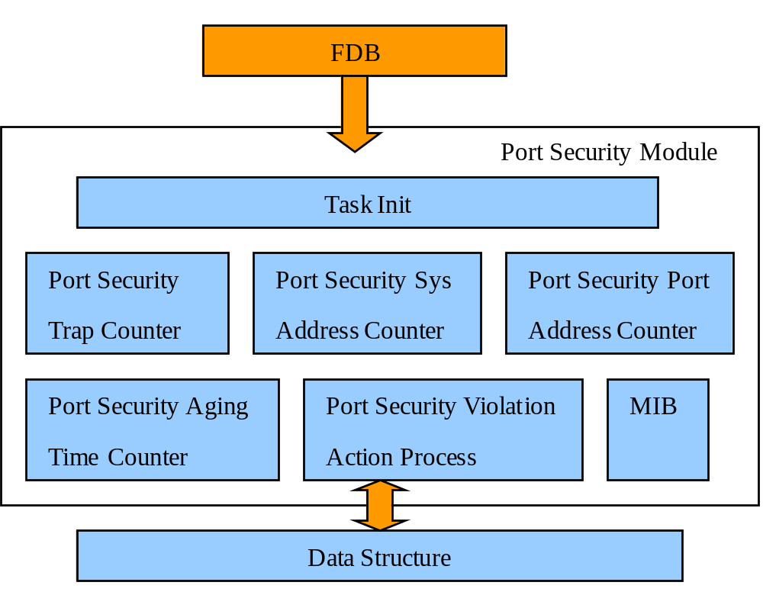
Port Security的学习
(2).Port Security的架构

Slide 3
Port Security的学习
(3).Port Security的源代码追踪
最终调用的NPAPI
cmPortSecState、cmPortSecMLA、cmPortSecLockAddrMode ——>CmNPPortSecSet
cmPortSecSysMaxAddr ——>CmNPNewMacDropSet
CmPortSecAgingTimerHandle——>CmNPPortSecSAHitGet
cmPortSecViolationAction、cmPortSecAgingTime、cmPortSecAgingType ——>CmNPPortSecViolationCountClear
CmPortSecViolationCountGetTimerHandle——>CmNPPortSecViolationCountGet

Slide 4
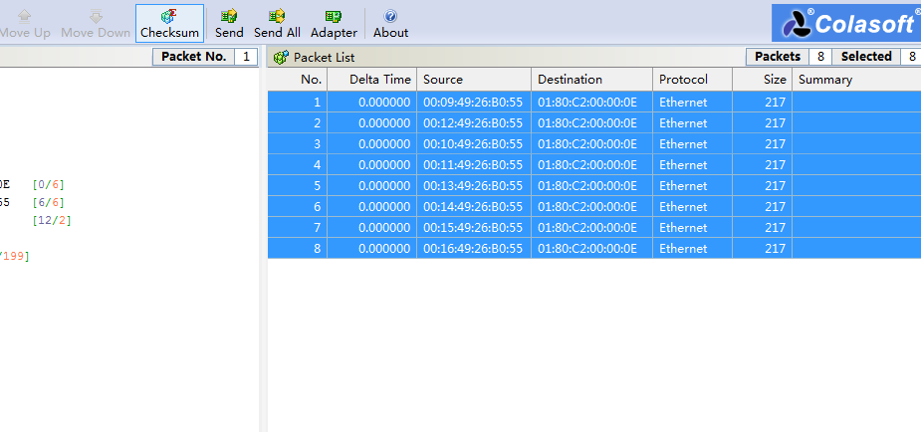
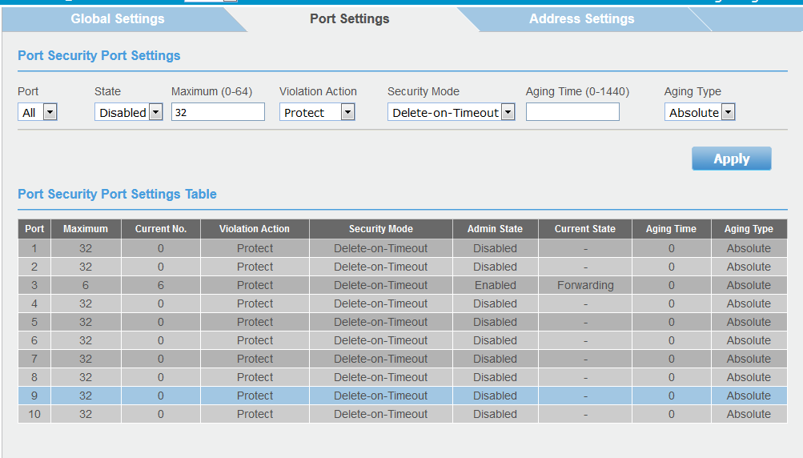
Port Security的测试过程
我首先采取了交换机直连PC的方式，连接了交换机的Port 3，采取了发送8个单播包。
首先给Port3 enable并将端口Maximum Mac通过量为6，虽然发了8个包但是只接收到了6个包。

Slide 5
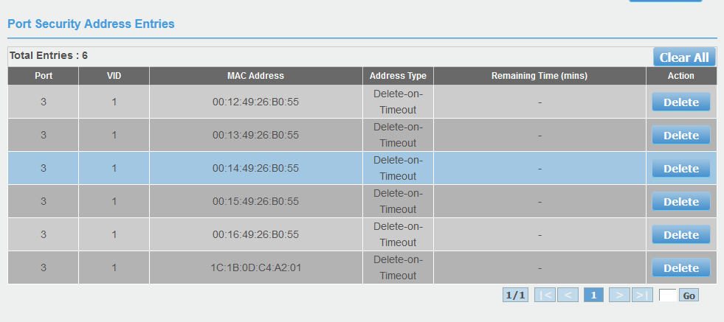
Port Security的测试过程

Slide 6
Port Security的测试过程
Port Security的测试结果
通过internal mib and WEB测试Port Security功能是否正常以及解决了一个疑问。
疑问：当per port都设为disable时，不限速时，Global System可以设置的最大MAC数为多少？
这个问题由于机器受限无法测试，询问过建强，建强给出的建议是当disable并不给最大值设值时，每个Port最大值默认值是32，所以我们只需将32*端口数，System设定的最大值大于等于这个值就行了，我们的机器即位于区间(256~6656)就行了。
而这个System所谓能设置的最大值的最小值则是per port所设定最大值之和。
后面由于有了机器，设置：port 2~8 maximum为1，port 1为 5 ，state都为disable，Global 设为12，通过port 1给switch打13个包，通过机器SDK命令查看发现port 1被限制在了12个包。所以得出结论global port settings虽然基于 per port，但是per port不限速时仍然受限于global settings。

Slide 7
Port Security的Spec.
3.26.1 | Fundamental
3.26.1.1 | The port security can be set enablement and disablement per port. | M | FC
3.26.1.2 | Global System: The maximum quantity to limite all ports learnt entry is 6656 when it is "limit". The System Max Learning entry can be exceeded when it is not "limit". Per Port: The maximum quantity to limite the per port learnt entry is 64 when state is "enabled" Thse System Max Learning entry can be exceeded when state is "disabled" | M | FC
3.26.1.3 | When a port's state of port security is set from enablement to disablement, all mac address entries learnt on this port should be cleared no matter what its security mode is. | M | FC
3.26.1.4 | System MUST NOT allow to set max learnt entries to “0” to all ports when all their admin states of port security are set to enablement. | M | FC
3.26.1.5 | When a port's state of port security is set to enablement and security mode is placed to “Delete-on-Timeout”, all mac address entries learnt on this port should be cleared while aged by following the aging time set. | M | FC
3.26.1.6 | When a port's state of port security is set to enablement and security mode is placed to “Permanent ”, all mac address entries learnt on this port should be left until the switch reboots. | M | FC
3.26.1.7 | When a port’s security mode is placed to “Permanent”, the port’s manually added port security address entries are placed to "Permanent". When saving config, the "permanent" port security mac entries can not be stored after sytem reboot. | M | FC
3.26.1.8 | When a port's admin state of port security is set to enablement , the amount of learn mac address entry MUST NOT exceed the “max learning address” set. | M | FC
3.26.1.9 | When Port Security Violation Action is "Protect", Only invalid data frames are discarded(The source MAC of the data frame is not in the security address table item, and the security address has reached the maximum number) and others operating normally. | M | FC
3.26.1.10 | Port Security Aging Time range is 0~1440(min) | M | FC
3.26.1.11 | When Port Security Aging Type is "Absolute",All the secure addresses on this port age out exactly after the time (minutes) specified and are removed from the secure address list. | M | FC
3.26.1.12 | When port security mode changed from "Permanent" to "Delete-on-Timeout",all mac address entries learnt on this port could be cleared. | M | FC
3.26.1.13 | When port security mode changed from "Delete-on-Timeout" to "Permanent",all mac address entries learnt on this port could be cleared. | M | FC

Slide 8
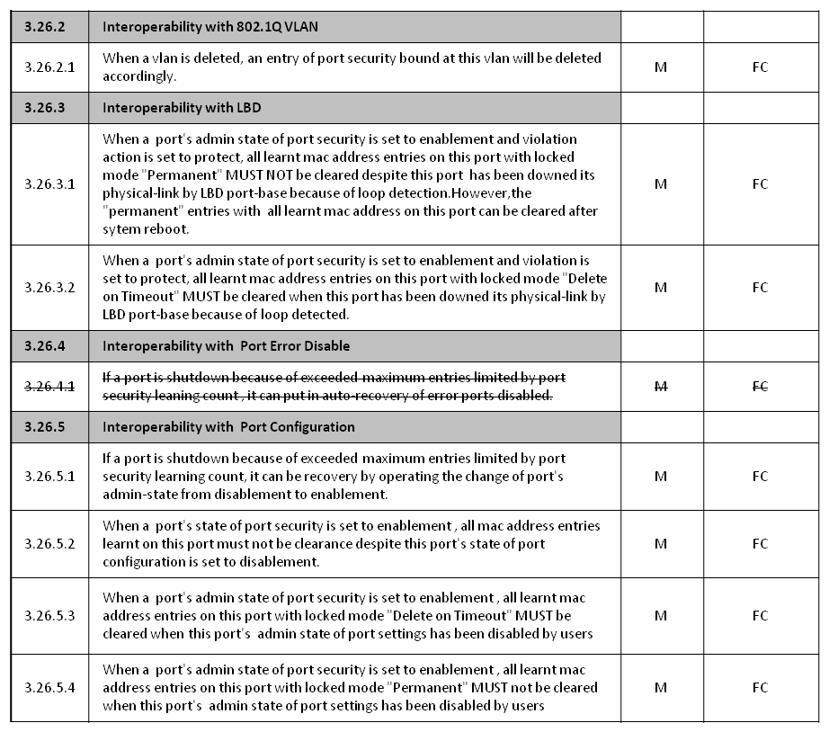
Port Security的Spec.

Slide 9
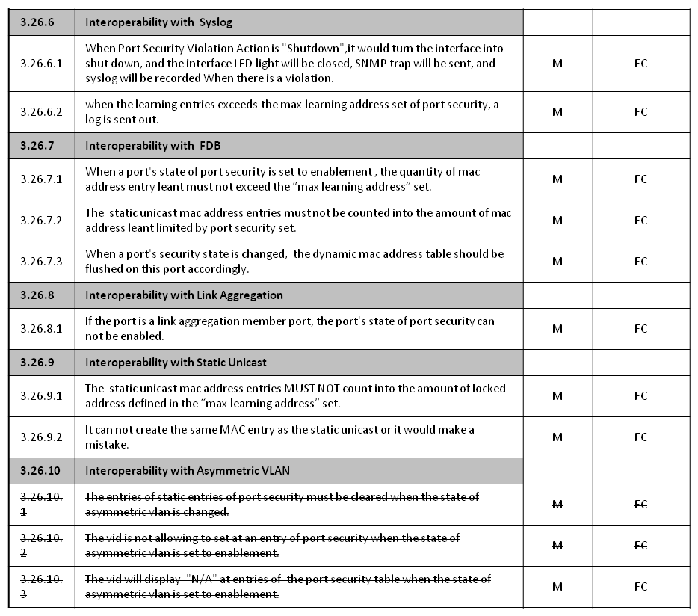
Port Security的Spec.

Slide 10
Port Security的实现
(1).修改的NPAPI
Finished NPAPI implementation for RTL9303
一、CmNPPortSecSet
实现逻辑
Enable时，指定limiting learning number为MLA，action为 ACTION_DROP,分别通过SDK API rtk_l2_limitLearningNum_set和rtk_l2_limitLearningAction_set进行设定
Disable时，指定limiting learning number为-1，action不设，同样通过API rtk_l2_limitLearningNum_set设定
Enable设定之后flush FDB by per port
具体实现的是SDK中的这段命令
diag shell command:
指定MLA: max_count
l2-table set limit-learning ( port | trunk )
( <MASK_LIST:port_trunk> | all ) <UINT:max_count>
指定action: drop
l2-table set limit-learning ( port | trunk )
( <MASK_LIST:port_trunk> | all ) action ( copy-to-cpu | drop | forward | trap-to-cpu )

Slide 11
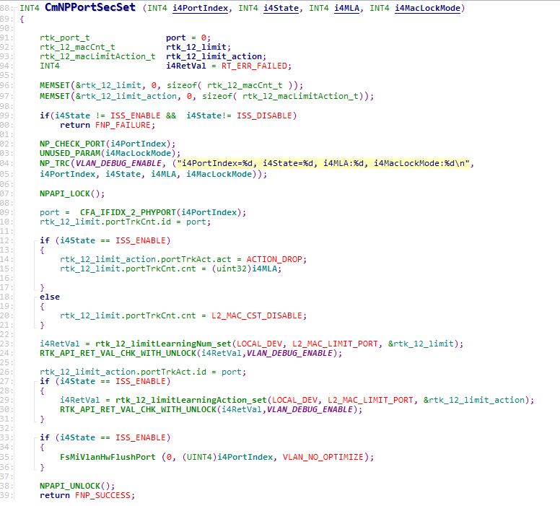
Port Security的实现

Slide 12
Port Security的实现
二、CmNPNewMacDropSet
实现逻辑
Enable时，指定mode为NOT_LEARNING，action为ACTION_DROP
Disable时，指定mode为HARDWARE_LEARNING,action为ACTION_FORWARD
以上参数通过rtk_l2_portNewMacOp_set设定至HW
SDK源码命令
enable时设定行为为not learn
disable时设定行为为asic-learn和forward
diag shell command:
l2-table set src-mac port ( <PORT_LIST:port> | all )
learn-mode ( asic-learn | software-learn | not-learn ) action ( copy-to-cpu | drop | forward | trap-to-cpu )

Slide 13
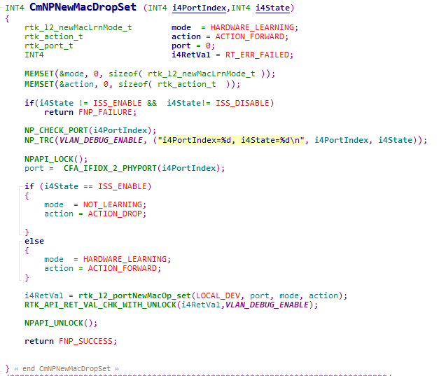
Port Security的实现

Slide 14
Port Security的实现
修改过程中遇到的BUG
When make -f myMakefile , it would turn wrong: undefined of CFA_NP_IS_PHY_PORT.
The mistake comes from NP_CHECK_PORT ,it missed the definition of ‘CFA_NP_IS_PHY_PORT’.
So I added
#define CFA_NP_IS_PHY_PORT(ifIndex) \
(((ifIndex > 0) && (ifIndex <= (UINT4)SYS_DEF_MAX_PHYSICAL_INTERFACES)) \
? FNP_TRUE : FNP_FALSE)
In it then it was OK.

Slide 15
Port Security的实现
三、修复的NPAPI:FsMiVlanHwFlushPort
问题：config.flushStaticAddr报错
原因：我们的switch不支持config.flushStaticAddr
#if defined(CONFIG_SDK_RTL8390) || defined(CONFIG_SDK_RTL8380)
rtk_enable_t flushStaticAddr;
#endif
可见只支持8390和8280的机型，不支持我们9303的机型
解决办法：把config.flushStaticAddr这一行删除了
然后参考了SDK中以及原先程序结构

Slide 16
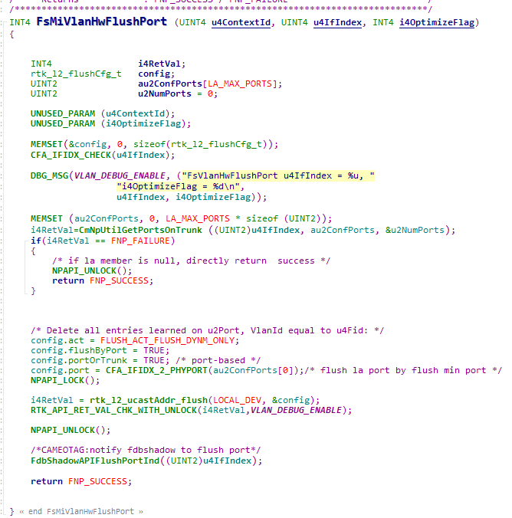
Port Security的实现
检测发现还需要添加config.act = FLUSH_ACT_FLUSH_DYNM_ONLY;这句代码。
由于NPAPI:FsMiVlanHwFlushPort函数功能是清除学到的MAC地址，而我们需要的是清除（Dynamic地址）。所以将act设为FLUSH_ACT_FLUSH_DYNM_ONLY。

